Slide 1
Beyond Boundaries: Co-creating Future Automotive Value Chain
Bharat Mandapam, Pragati Maidan, New Delhi
1st to 3rd February 2024
For more details visit : www.bharat-mobility.com

Slide 2
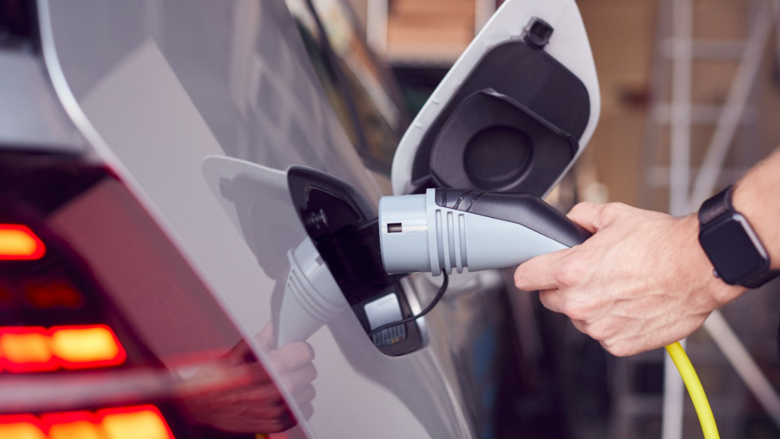
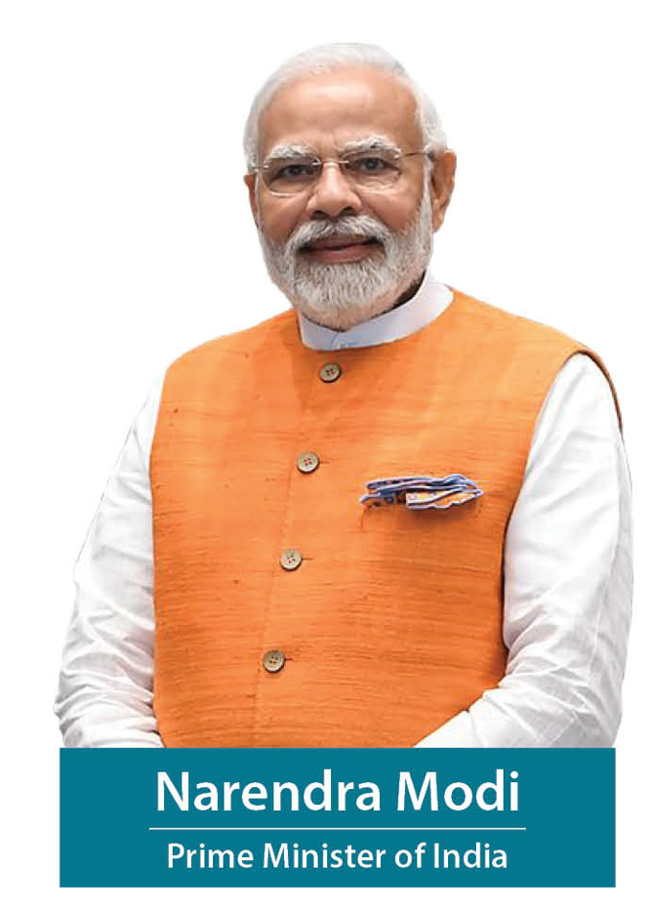
Inspired by the 7Cs
Common
Connected
Convenient
Congestion - free
Charged
Clean
"The need of the hour today is to develop a mobility ecosystem that is sustainable and in harmony with the environment. Environmentally-conscious and economically viable mobility is the future."
Cutting - edge

Slide 3
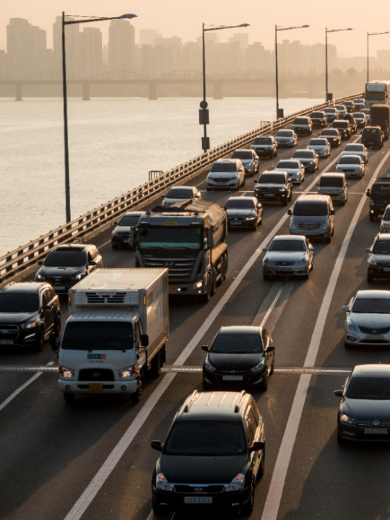
Image
India’s first global mobility expo
Bharat Mobility Global Expo 2024 celebrates India’s growing role as a global hub for mobility, showcasing success across the automotive and mobility value chain and cutting-edge technologies – all seamlessly presented under one roof

Slide 4
Why Bharat Mobility Global Expo 2024 is a unique event
A Truly
Global Event
Full Mobility Ecosystem Presence
Government, Associations, Industry come together
From Automobiles to Automotive Components, EV Batteries, Charging Infrastructure, Tyres, New Mobility Systems, Automotive Steel and Technology Solutions.
Participation from more than 50+ countries, and more confirmations expected
9 ministries, 11 apex industry associations and several industry leaders come together

Slide 5
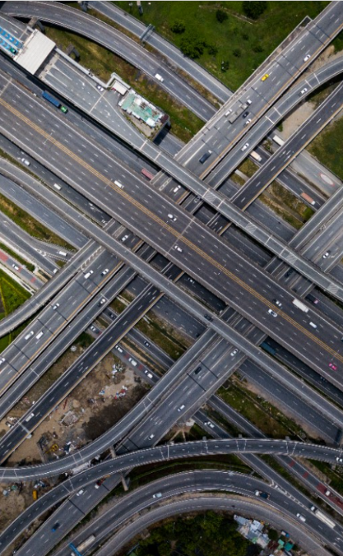
A confluence of the world’s leading automotive and mobility players
Hosted by Industry associations and supported by Ministry of Commerce & Industry, Bharat Mobility Global Expo 2024 is one-of-its kind confluence covering the entire mobility ecosystem
600+
Exhibitors
50+
Overseas Players
80,000+
Event
Visitors
1,00,000+
Sq. Meters Area
13+
Knowledge Sessions

Slide 6
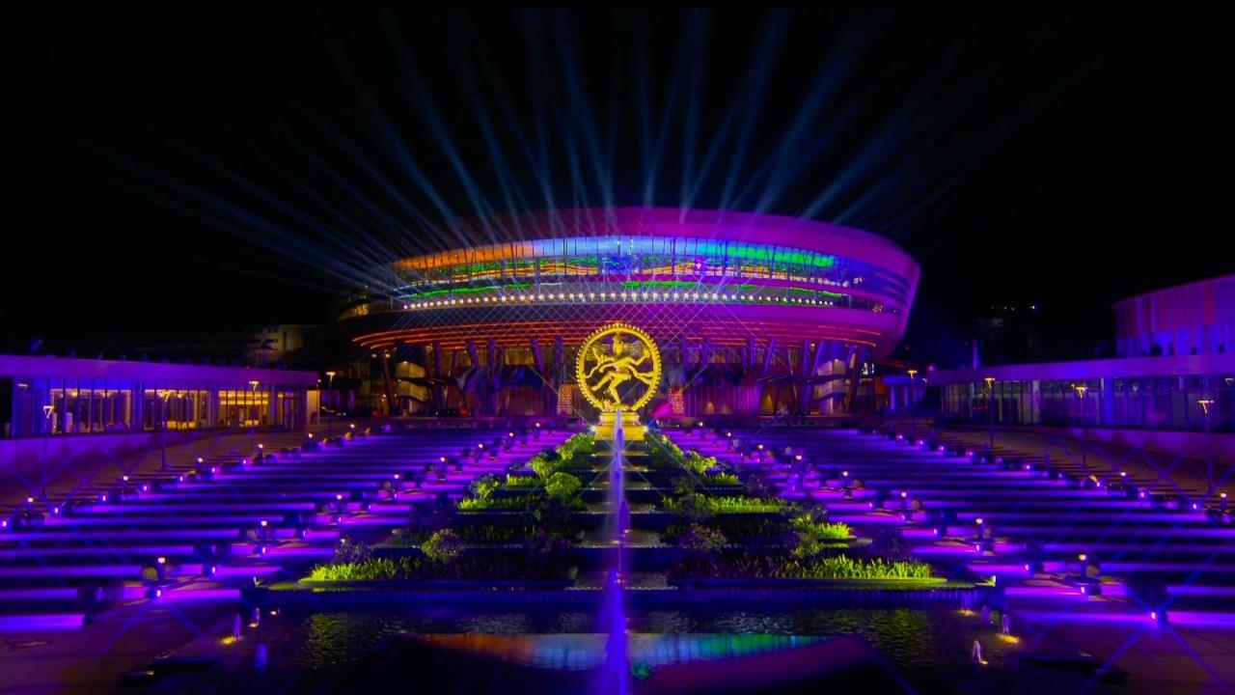
Date: 1st – 3rd February 2024
Venue: Bharat Mandapam, Pragati Maidan, New Delhi

Slide 7
Partner Organizations
Supported by
Coordinating Agency
Knowledge Partner

Slide 8
Other Supporting Ministries

Slide 9
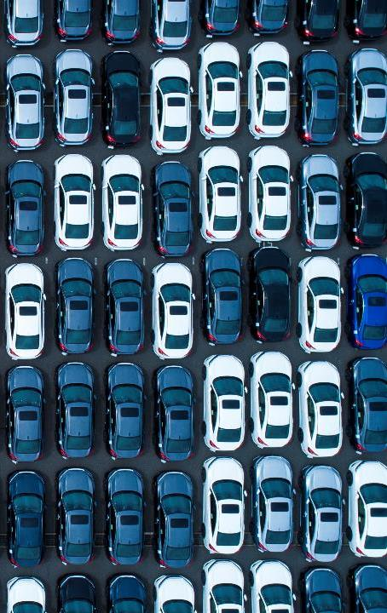
Focus Areas for Bharat Mobility Global Expo 2024
Supply Chain Encompassing Steel, Rubber and Machine Tools
Automobile & Powertrain Technologies
Construction Equipment Machinery
Auto Components, New Age and Aftermarket
10
01
09
Focus Areas
02
Innovative Technology Solutions
Electrical and Electronics and Mechanical Subsystems
08
03
07
04
Infrastructure for Charging and Other Energy Sources
06
05
Next-gen, Eco-friendly Tyres
Battery Technologies and Circular Economy
Urban Mobility Including Bicycles, e-Bikes

Slide 10
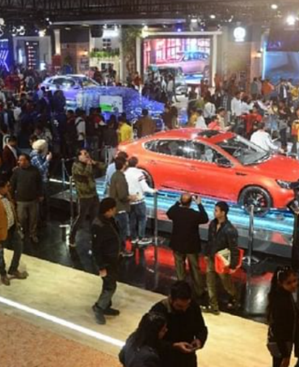
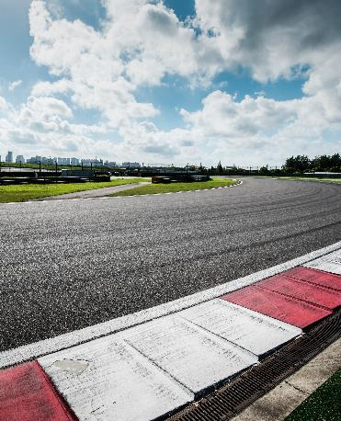
Bharat Mobility Global Expo 2024 – Elements
01. Exhibition
02. Conferences
03. More Attractions

Slide 11
Exhibition - Participants as on date
27
Leading Vehicle
OEMs (incl. pure
EV players)
400+
Component Manufacturers
40+
Battery and Storage Companies
10+
Leading Tyre Manufacturers
EV Pavilion
10
Electric Mobility Companies
5
Leading Steel Manufacturers
8
Leading Technology and Start-up players

Slide 12
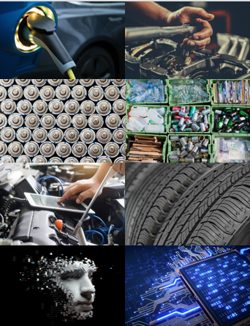
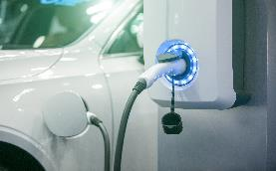
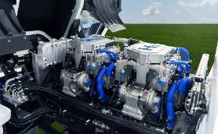
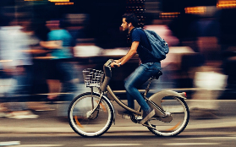
Conferences
Discussions on disruptive, cutting-edge and new age opportunities in the mobility space by national and international experts
Battery Manufacturing & Recycling
Electrification & Battery Safety
Knowledge sessions
Circular Economies & Sustainability
Networking sessions
AI & Metaverse in Industry 4.0
ADAS and Security
Government initiatives
Software Defined Vehicles
Dialogue & conclave
Ethanol & Alternate Powertrains
Urban Mobility

Slide 13
13 Conferences across the Automotive Value Chain
Day 01
2nd edition of ISTEM – International Symposium for Thriving Eco-Energy in Mobility*
2nd Annual EV Battery Safety Forum
Co-creating tech capabilities from India for Software Defined Vehicles
Dialogue between ATMA/ITTAC & Global Tyre Industry Associations
EV: Driving the Auto Industry
Day 02
3rd Global Electrification Mobility Summit (GEMS)
Conference on Circular Economy & Sustainability
Battery Manufacturing & Circular Economy
Tech Innovation from India for ADAS and Security capabilities
AI and Metaverse for Industry 4.0
Day 03
2nd edition of International Conference on Sustainable Circularity**
Workshop on Tyre Care & Safety
EV Infra (Charging & Swapping) Leadership summit
*Theme: “Nature based Solutions: Road to Decarbonization”
**“Theme : Towards Nature Positive Pathways: Embracing regime of EPR with low-carbon strategies and Recycling in Automotive Sector”

Slide 14
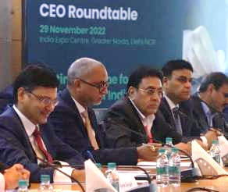
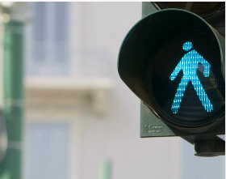
More Attractions
Buyer-Seller Meets
State Sessions
CEO Conclave
SIAM Surakshit Safar Pavilion (Road Safety)*
Go Karting
*The objective is to educate citizens about comprehensive aspects and importance of road safety.

Slide 15
THANK YOU
For more details on participation and sponsorship opportunities, visit us at:
www.bharat-mobility.com

